Slide 1


OTA Booking Data Analysis
Key Insights and Recommendations
Presented By: Manish Shukla

Slide 2


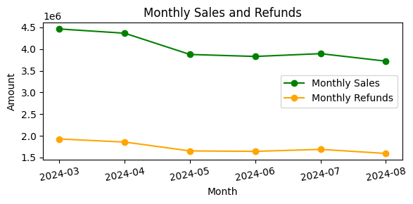
Sales and Refund Trends
Monthly Sales vs Refund Trends
What we found:
Sales were relatively steady month-to-month, but we noticed some spikes in refunds.
Why this matters:
Refund spikes may indicate issues such as customer dissatisfaction, travel disruptions, or changes in travel plans.
Potential reasons:
Refund spikes could be linked to external factors like cancellations or seasonal fluctuations in travel plans.

Slide 3
Selling Price Distribution
What we found:
Prices ranged widely from around ₹50 to over ₹ 2,000, but most tickets were sold at the lower end of the range (between ₹ 50 and ₹ 500).
Why this matters:
The wide range reflects a mix of budget-conscious travelers and premium customers. Most of the sales are for more affordable tickets.
Potential reasons:
This could suggest that customers tend to favor lower-cost options, or that the OTA specializes in economy or budget flights.

Slide 4
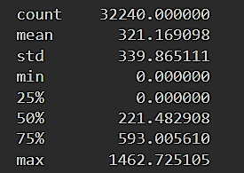
Refund Amount Analysis
Refund Amount Breakdown
What we found:
The average refund was around ₹ 321, but there’s a spread of refund amounts.
Why this matters:
Refunds, especially large ones, can affect profitability. High-value refunds could suggest an issue with cancellations or reliability.
Potential reasons:
Larger refunds might be tied to more expensive tickets with more flexible refund policies, while cheaper tickets could be less likely to be refunded.

Slide 5

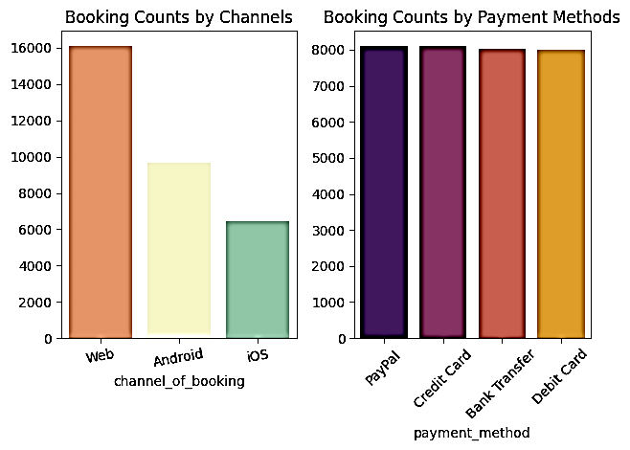
Booking Channels
How Customers Are Booking
What we found:
Most bookings were made through Direct or Agency channels, while fewer came through Partner channels.
Why this matters:
Knowing where the majority of your bookings are coming from helps focus marketing efforts.
Potential reasons:
Direct and Agency channels might be more familiar to customers, offer better deals, or be more convenient to use.

Slide 6
Markup and Profit Analysis
Markups and their Impact on Profit
What we found:
There’s a strong relationship between markup and profit. Higher markups lead to higher profits, which seems pretty intuitive.
Why this matters:
Strategic price adjustments can significantly boost profitability.
Potential reasons:
Markups might vary based on demand, routes, or ticket class. It’s important to strike a balance between being competitive and maintaining healthy margins.

Slide 7

What Can Be Done Next..?
1. Minimize Refunds:
Offer better customer support and clearer communication to reduce cancellations.
Work more closely with suppliers to minimize disruptions like flight cancellations.
Consider offering incentives for customers to rebook rather than cancel.
2. Optimize Pricing:
Experiment with dynamic pricing, especially during peak seasons, to maximize revenue without driving away customers.
Focus on adjusting markups where demand is high to boost profits.
3. Leverage Key Channels:
Since Direct and Agency channels bring in the most bookings, increase your marketing spend on these channels to further boost sales.
Look into ways to improve performance on Partner channels or negotiate better terms with them to improve results.

Slide 8

Conclusion
In summary, sales are steady, but we’ve identified some areas for improvement, especially in reducing refunds and optimizing pricing.
By adjusting pricing strategies and focusing on top-performing channels, the OTA can enhance profitability.
Next steps would involve testing these recommendations and monitoring their impact on overall performance.

